Slide 1
Eleven Advanced Optimizations of Cache Performance

Slide 2
Members

Slide 3
Reducing the hit time:
Small and simple caches
Way prediction
Trace caches

Slide 4
Small and simple caches

Slide 5
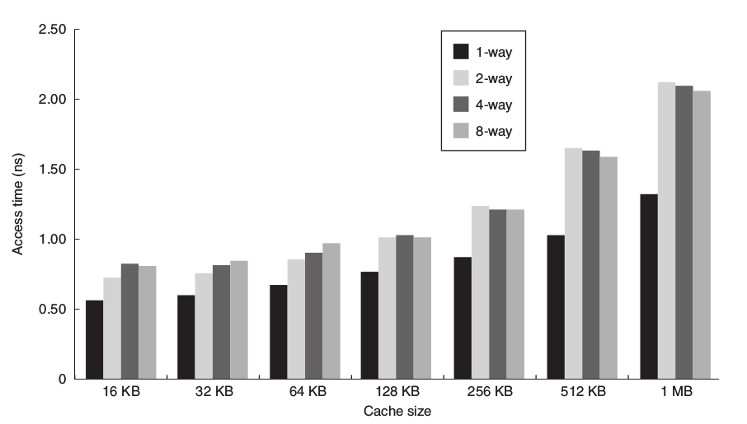
Small and Simple Caches

Slide 6
Small and Simple Caches
Small size => Less index => faster access
Small size => fit on the chip, lower delay
Simple (direct mapped) => lower dela

Slide 7
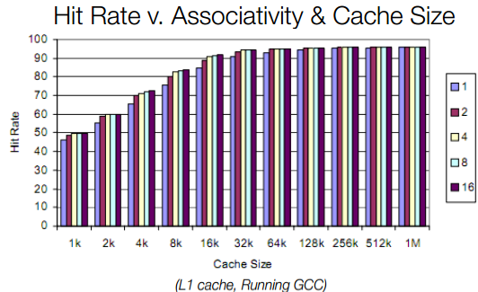
Small and Simple Caches
Smallest is best ? 1 byte ?
Directly cache ?
View hit rate table

Slide 8
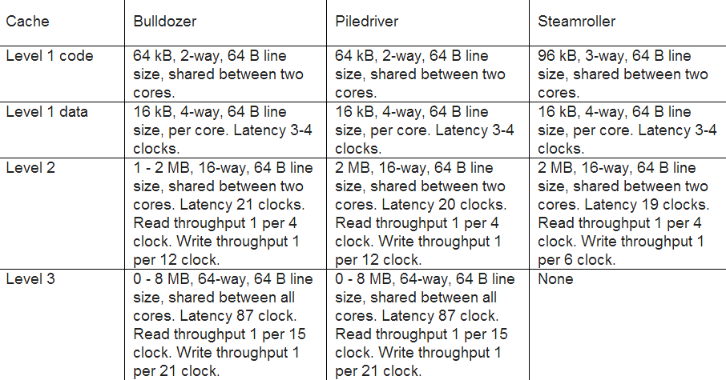
Small and Simple Caches
Good choice: 64 kb and two way associative

Slide 9
Way prediction

Slide 10
Way Prediction
Fast hit time of direct-mapped + lower conflict misses of 2-way ?
Way prediction: keep extra bits in cache to predict “way” (block within set) of next access
Accuracy ~ 85%

Slide 11
Trace caches

Slide 12
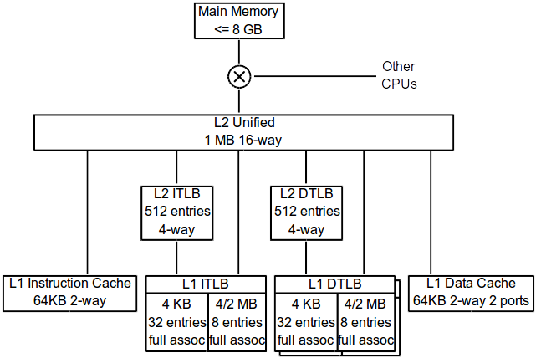
Trace Caches
What is instruction cache ?
Architecture K8 core in the AMD Athlon 64

Slide 13
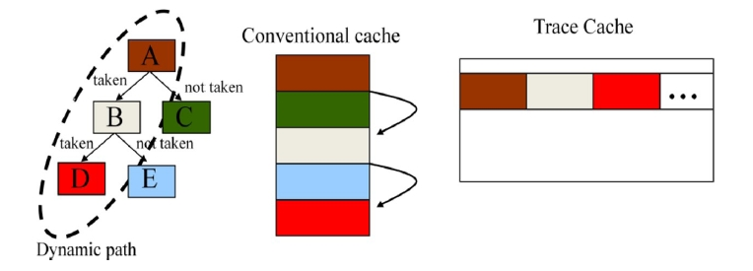
Trace Caches
Dynamic traces of the excuted instructions
Built-in branch predictor
Decode/translate from x86 to micro-ops

Slide 14
Trace Caches
Expensive in area, power, and complexity compared to its benefits.
Not popular.
Use on Pentium 4 family CPU.

Slide 15
Increasing cache bandwidth: Pipelined caches
Nonblocking caches
Multibanked caches

Slide 16
Pipelined caches

Slide 17
Pipelined caches
Pipeline cache access
High Bandwidth
Fast clock cycle time
Slow hit time

Slide 18
Pipelined caches
Effective latency of L1 cache hit is multiple clock cycles.
E.g., To access instruction cache:
  Pentium: 1 cc
  Pentium Pro through Pentium III: 2 cc
  Pentium 4: 4 cc

Slide 19
Pipelined caches
Increases the number of pipeline stages.
  Leading to greater penalty on mispredicted branches.
  More clock cycles between the issue of the load and the use of the data.

Slide 20
Nonblocking caches

Slide 21
Nonblocking caches
Processor need not stall on cache miss.
Continue fetching instructions while waiting for cache data.
Non-blocking cache or lockup-free cache allow data cache to continue to supply cache hits during a miss.

Slide 22
Nonblocking caches
Hit under miss reduces effective miss penalty by working during miss vs. ignoring CPU requests.

Slide 23
Nonblocking caches
Hit under multiple miss or miss under miss may further lower the effective miss penalty by overlapping multiple misses.

Slide 24
Multibanked caches

Slide 25
Multibanked caches
Rather than treat the cache as a single monolithic block, divide into independent banks that can support simultaneous accesses.
E.g., L2 Cache AMD : 2 bank
L2 Cache Sun Niagara: 4 bank

Slide 26
Multibanked caches
Banking works best when accesses naturally spread themselves across banks.
Mapping of addresses to banks affects behavior of memory system.

Slide 27
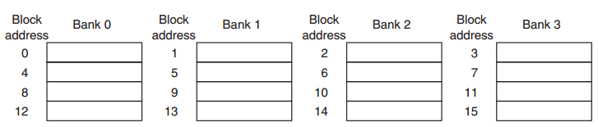
Multibanked caches
Simple mapping works well is sequential interleaving.

Slide 28
Reduce Miss Penalty:
Critical Word First, Early Restart
Merging Write Buffer
Compiler Optimizations

Slide 29
Critical Word First, Early Restart

Slide 30
Critical Word First, Early Restart
Processor usually needs one word of the block at a time.
Do not wait for full block to be loaded before restarting processor:

Slide 31
Critical Word First, Early Restart
  Critical Word First: request the missed word first from memory, send it to the processor as soon as it arrives, let the processor continue execution while filling the rest of the words in the block.
  Also called wrapped fetch and requested word first.

Slide 32
Critical Word First, Early Restart
Early restart: as soon as the requested word of the block arrives, send it to the processor and let the processor continue execution.

Slide 33
Critical Word First, Early Restart
Benefits of critical word first, early restart depend on:
  Block size: generally useful only in large blocks.
  Likelihood of another access to the portion of the block that has not yet been fetched:
    Spatial locality problem: tend to want next sequential word, so not clear if benefit.

Slide 34
Merging Write Buffer

Slide 35
Merging Write Buffer
Write buffer to allow processor to continue while waiting to write to memory.
If buffer contains modified blocks, the addresses can be checked to see if address of new data matches the address of a valid write buffer entry. If so, new data are combined with that entry.
Increases block size of write for write‐through cache of writes to sequential words, bytes since multiword writes more efficient to memory.

Slide 36
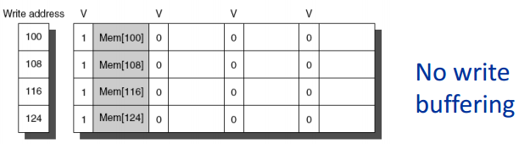
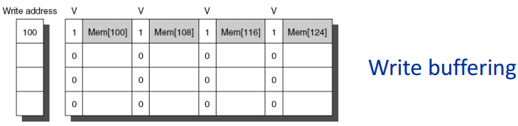
Merging Write Buffer
When storing to a block that is already pending in the write buffer, update write buffer.
Reduces stalls due to full write buffer:

Slide 37
Compiler Optimizations

Slide 38
Compiler Optimizations
Instructions:
  Reorder procedures in memory so as to reduce conflict misses.
  Profiling to look at conflicts (using tools they developed).

Slide 39
Compiler Optimizations
Loop Interchange: swap nested loops to access data in order stored in memory (in sequential order).
Loop Fusion: Combine 2 independent loops that have same looping and some variables overlap.

Slide 40
Compiler Optimizations
Blocking: Improve temporal locality by accessing blocks of data repeatedly vs going down whole columns or rows:
Instead of accessing entire rows or columns, subdivide matrices into blocks.
Requires more memory accesses but improves locality of accesses.

Slide 41
Q & A

Slide 42
Thank you for your attention

